Slide 1
Remote Procedure Call (RPC)

Slide 2
History
1984: Birrell & Nelson
  Mechanisms to call procedures on other machines
  Processes on machine A can call procedures on machine B
    A is suspended
    Execution continues on B
    When B returns, control passed back to A
Goal: it appears to the programmer that a normal call is taking place

Slide 3
Introduction
The Remote Procedure Calls (RPC) mechanism is a high-level communications paradigm for network applications.
RPC is a powerful technique for constructing distributed, client/server based applications.
It is based on extending the notion of conventional, or local procedure calling,
  so that the called procedure need not exist in the same address space as the calling procedure.
  The two processes may be on the same system, or they may be on different systems with a network connecting them.

Slide 4
Introduction
By using RPC, programs on networked platforms can communicate with remote (and local) resources.
RPC allows network applications to use specialized kinds of procedure calls designed to hide the details of underlying networking mechanisms.

Slide 5
Procedure
Same as routine, subroutine, and function. A procedure is a section of a program that performs a specific task.
An ordered set of tasks for performing some action.

Slide 6
Terms and Definitions
Client- A process, such as a program or task, that requests a service provided by another program.
Server- A process, such as a program or task, that responds to requests from a client.
Client Stub- Module within a client application containing all of the functions necessary for the client to make remote procedure calls using the model of a traditional function call in a standalone application. The client stub is responsible for invoking the marshalling engine and some of the RPC application programming interfaces (APIs).
Server Stub - Module within a server application or service that contains all of the functions necessary for the server to handle remote requests using local procedure calls.

Slide 7
How RPC Works
An RPC is analogous to a function call. Like a function call, when an RPC is made, the calling arguments are passed to the remote procedure and the caller waits for a response to be returned from the remote procedure.
The client makes a procedure call that sends a request to the server and waits.
The thread is blocked from processing until either a reply is received, or it times out. When the request arrives, the server calls a local procedure that performs the requested service, and sends the reply to the client.
After the RPC call is completed, the client program continues. RPC specifically supports network applications.

Slide 8

one procedure (caller) calls another procedure (callee)
the caller waits for the result from the callee
the callee receives the request, computes the results, and then send them to the caller
the caller resumes upon receiving the results from the callee
How RPC Works
CALLER
arguments
CALLEE
invokes a procedure on the callee
receives the request
waits
computes the results
sends the results
results
resumes
RPC call between two networked systems

Slide 9
Remote Subroutine
Client
Server
bar = foo(a,b);
int foo(int x, int y ) {
if (x>100)
return(y-2);
else if (x>10)
return(y-x);
else
return(x+y);
}
protocol

Slide 10
Client and Server
Machine A
Machine B
count = doSomething();
procedure doSomething();
Client Stub
Server Stub
OS
OS

Slide 11
Remote procedure call (RPC)
A remote procedure call makes a call to a remote service look like a local call
  RPC makes transparent whether server is local or remote
  RPC allows applications to become distributed transparently
  RPC makes architecture of remote machine transparent

Slide 12
Remote Procedure Call (RPC)
The most common framework for newer protocols and for middleware
Used both by operating systems and by applications
  NFS is implemented as a set of RPCs
  DCOM (Distributed Component Object Model) is a proprietary Microsoft technology for communication among software components distributed across networked computers.
  CORBA (Common Object Request Broker Architecture) is a standard defined by the Object Management Group (OMG) that enables software components written in multiple computer languages and running on multiple computers to work together (i.e., it supports multiple platforms).
  Java RMI (Java Remote Method Invocation) enables the programmer to create distributed Java technology-based to Java technology-based applications, in which the methods of remote Java objects can be invoked, possibly on different hosts. etc., are just RPC systems

Slide 13
Remote Procedure Call (RPC)
Fundamental idea: –
  Server process exports an interface of procedures that can be called by client programs
Clients make local procedure/function calls
  - Under the covers, procedure/function call is converted into a message exchange with remote server process

Slide 14
Developing with RPC
Define APIs between modules
  Split application based on function, ease of development, and ease of maintenance
  Don’t worry whether modules run locally or remotely
Decide what runs locally and remotely
  Decision may even be at run-time
Make APIs bullet proof
  Deal with partial failures

Slide 15
The RPC model
client
server
Calls procedure and wait for reply
request
Receives request and starts process execution
Sends reply and wait for next execution
reply
Resumes execution
Blocking state
Executing state
RPC to be transparent- the calling procedure should not be
aware that called procedure is executing on a different machine

Slide 16
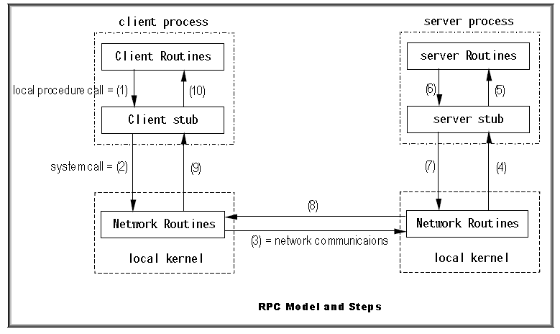
RPC Execution Steps

Slide 17
Cont…
(1) The client calls the procedure. It calls the client stub, which packages the arguments into network messages. Packaging is called marshaling.
(2) The client stub executes a system call (usually write or sendto) into the local kernel to send the message.
(3) The kernel uses the network routines (TCP or UDP) to send the network message to the remote host. Note that connection-oriented or connectionless protocols can be used.
(4) A server stub receives the messages from the kernel and unmarshals the arguments.
(5) The server stub executes a local procedure call to start the function and pass the parameters.
(6) The server process executes the procedure and returns the result to the server stub.
(7) The server stub marshals the results into network messages and passes them to the kernel.
(8) The messages are sent across the network.
(9) The client stub receives the network messages containing the results from the kernel using read or recv.
(10) The client stub unmarshals the results and passes them to the client routine.

Slide 18
Stubs
Client stub
  Marshals arguments into machine-independent format
  Sends request to server
  Waits for response
  Unmarshals result and returns to caller
Server stub
  Unmarshals arguments and builds stack frame
  Calls procedure
  Server stub marshalls results and sends reply

Slide 19
Marshalling Arguments
Marshalling is the packing of function parameters into a message packet
  The RPC stubs call functions to marshal or unmarshal the parameters
    Client stub marshals the arguments into a message
    Server stub unmarshals the arguments and uses them to invoke the service function (to execute the procedure locally)
  on return:
    the server stub marshals return values
    the client stub unmarshals return values, and returns to the client program

Slide 20
Marshalling
Argument encoding sometimes called marshalling
Decoding -> unmarshalling
issues
Data types
Conversion

Slide 21


Representation of data
In a large distributed system, multiple machine types are present
Each machine has its own representation for number, characters, and others data items.
Original message on the Pentium (little-endian)
The message after receipt on the Sun SPARC (big-endian )
The message after being inverted. The little numbers in boxes indicate the address of each byte

Slide 22
Representation of Data (continued)
The Sun RPC uses a standard format called XDR(eXternal Data Representation), a protocol for the machine-independent description and encoding of data.
XDR is an data abstraction needed for machine independent communication. The client and server need not be machines of the same type.
XDR is useful for transferring data between different computer architectures.
RPC can handle arbitrary data structures, regardless of different machines' byte orders or structure layout conventions, by always converting them to XDR representation before sending them over the wire.
The process of converting from a particular machine representation to XDR format is called serializing, and the reverse process is called deserializing.

Slide 23
Semantics
Call-by-reference not possible: the client and server don't share an address space. That is, addresses referenced by the server correspond to data residing in the client's address space.
One approach is to simulate call-by-reference using copy-restore. In copy-restore, call-by-reference parameters are handled by sending a copy of the referenced data structure to the server, and on return replacing the client's copy with that modified by the server.
However, copy-restore doesn't work in all cases. For instance, if the same argument is passed twice, two copies will be made, and references through one parameter only changes one of the copies.

Slide 24
RPC Binding
How does the client know who to call, and where the service resides?
The most flexible solution is to use dynamic binding and find the server at run time when the RPC is first made. The first time the client stub is invoked, it contacts a name server to determine the transport address at which the server resides.

Slide 25
RPC Binding
Binding is the process of connecting the client to the server
  the server, when it starts up, exports its interface
    identifies itself to a network name server
    tells RPC runtime that it is alive and ready to accept calls
  the client, before issuing any calls, imports the server
    RPC runtime uses the name server to find the location of the server and establish a connection
The import and export operations are explicit in the server and client programs

Slide 26
Basic Concepts
interface
NAME | type | type | type
procedure_X | arg1 | arg2 | ret1
procedure_Y | arg1 | ret1
procedure_Z | arg1 | ret1 | ret2
local program
program module
import procedure_X
…
call procedure_X(arg1,arg2,ret1)
…
remote program
program module
implement procedure_X(arg1,arg2,ret1)
{
…
}
export procedure_X

Slide 27
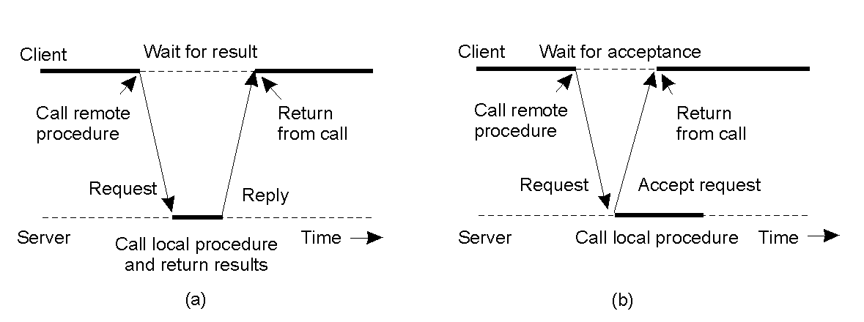
Asynchronous RPC
2-12
The interconnection between client and server in a traditional RPC
The interaction using asynchronous RPC

Slide 28
Cont …
Asynchronous RPC resolves the following limitations of traditional, synchronous RPC
Slow or delayed clients
Slow or delayed servers
Transfer of large amounts of data

Slide 29
RPC Issues
transparency-Applications should be prepared to deal with RPC failure
RPC is more vulnerable to failure
  machine failure (Server crash/Client crash while server is still running code for it)
  communication failure
address based arguments
  the address space is not shared
programming integration
  integration into programming environment
data integrity

Slide 30
RPC Issues
data transfer protocols
  network protocols
binding
  caller determines
    the location
    the identity
  … of the callee
security
  open communication network
  Authenticate client
  Authenticate server

Slide 31
RPC Implementation – Overview
Caller machine
Network
Callee machine
User
User - stub
RPCRuntime
RPCRuntime
Server - stub
Server
local call
pack argument
transmit
call packet
receive
unpack argument
call
wait
work
local return
unpack result
receive
result packet
transmit
pack result
return
importer
exporter
importer
exporter
interface
interface
Database
lookup
register

Slide 32
RPC Implementation – RPCRuntime
RPCRuntime deals with
data (re)transmission
data acknowledge
packet routing
encryption
binding
Caller
machine
Network
Callee
machine
RPCRuntime
RPCRuntime
transmit
call packet
receive
wait
receive
result packet
transmit
Database
lookup
register

Slide 33
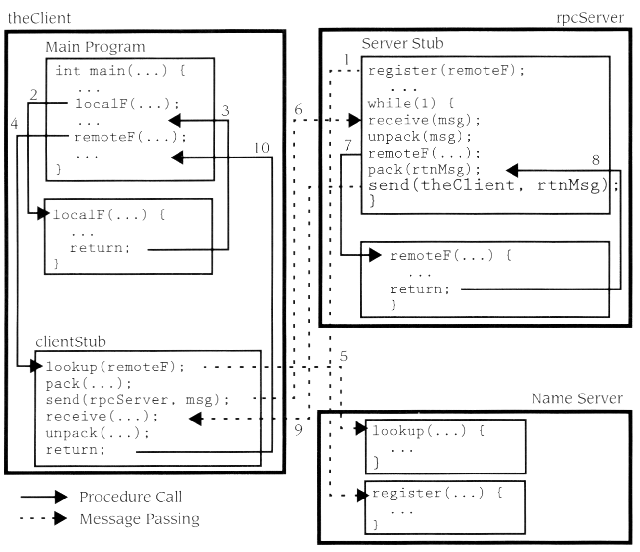
RPC Implementation – RPC flow
* Garry Nutt; Operating systems; 2nd Edition, Addison Wesley

Slide 34
Failures with RPC
Failure types may be:
  The client is unable to locate the server
    The server is not availaible
    The stubs versions are not adequate
  The client request towards the server is lost:
    After a timeout, the client retransmits the same request
  The server response from the server to the client is lost:
    The client will retransmit the same request.

Slide 35
Failures with RPC (contd..)
  The server is down after receiving the client request (3 cases):
    At least once:
      When the machine restarts, retransmits the requests many times until the response arrives.
    At most once:
      The operation is done either once or never.
    Exactly once:
      The most desirable kind of semantics, where every call is carried out exactly once, no more and no less.
      Unfortunately, such semantics cannot be achieved at low cost; if the client transmits a request, and the server crashes, the client has no way of knowing whether the server had received and processed the request before crashing.

Slide 36
RPC Application Development
To develop an RPC application the following steps are needed:
Specify the protocol for client server communication
Develop the client program
Develop the server program
The programs will be compiled separately. The communication protocol is achieved by generated stubs and these stubs and rpc (and other libraries) will need to be linked in.

Slide 37
The rpcgen Protocol Compiler
The easiest way to define and generate the protocol is to use a protocol compiler such as rpcgen.
rpcgen provides programmers a simple and direct way to write distributed applications.
rpcgen is a compiler. It accepts a remote program interface definition written in a language, called RPC Language, which is similar to C.

Slide 38
Contd…
It produces a C language output which includes stub versions of the client routines, a server skeleton, XDR filter routines for both parameters and results, and a header file that contains common definitions.
The client stubs interface with the RPC library and effectively hide the network from their callers.
The server stub similarly hides the network from the server procedures that are to be invoked by remote clients.

Slide 39
Contd…
The output of rpcgen is:
A header file of definitions common to the server and the client
A set of XDR routines that translate each data type defined in the header file
A stub program for the server
A stub program for the client

Slide 40
RPC specification
A file with a ``.x'' suffix acts as a remote procedure specification file. It defines functions that will be remotely executed.
Multiple functions may be defined at once. They are numbered from one upward, and any of these may be remotely executed.
The specification defines a program that will run remotely.
The program has a name, a version number and a unique identifying number (chosen by you).

Slide 41
RPC versions and numbers
Each RPC procedure is uniquely identified by a program number, version number, and procedure number.
The program number identifies a group of related remote procedures, each of which has a different procedure number.
Program numbers are given out in groups of hexadecimal 20000000.
0 - 1fffffff defined by Sun,
20000000 - 3fffffff defined by user
Version numbers are incremented when functionality is changed in the remote program.
More than one version of a remote program can be defined and a version can have more than one procedure defined.

Slide 42
Converting Local Procedures into Remote Procedures (an example)
Assume an application that runs on a single machine. Suppose we want to convert it to run over the network. [a simple example program that calculates pi]
To declare a remote procedure, first, determine the data types of all procedure-calling arguments and the result argument.

Slide 43
Contd…
Writing protocol specification in RPC language to describe the remote version of calcu_pi.
/* pi.x: Remote pi calculation protocol */
program PIPROG {
version CALCU_PIVERS {
double CALCU_PI() = 1;
} = 1;
} = 0x39876543;
The program PIPROG is 0x39876543, Version number referred to symbolically as CALCU_PIVERS is 1.

Slide 44
Contd…
In this example,
  CALCU_PI procedure is declared to be:
    the procedure 1,
    in version 1 of the remote program
  PIPROG, with the program number 0x39876543.
Notice that the program and procedure names are declared with all capital letters. This is not required, but is a good convention to follow.

Slide 45
Contd…
To compile a .x file using
rpcgen –a –C pi.x
where:
option –a tells rpcgen to generate all of the supporting files
option –C indicates ANSI C is used

Slide 46
Contd….
This will generate the files:
pi_clnt.c - the client stub - usually is not modified
pi_svc.c - the server stub - usually is not modified
pi.h - the header file that contains all of the XDR types generated from the specification
makefile.pi - makefile for compiling all of the client and server code
pi_client.c - client skeleton, need to be modified
pi_server.c – server skeleton, need to be modified
pi_xdr.c- Contains XDR filters needed by the client and server stubs – usually is not modified

Slide 47
rpcgen Files
pi_server.c
server files rpcgen common files client files
pi_svc.c
pi_xdr.c
pi.x
pi.h
makefile.pi
pi_clnt.c
pi_client.c

Slide 48
Contd…
Make changes to pi_client.c file to give actual arguments to call(if required) and to display the output. then save the changes and run the following command.
Compile the client side program and link it with client stub:
$ gcc pi_client.c pi_clnt.c -o pi_client –lnsl
Write the logic at the location indicated and save the changes. Now, run the last command.
Compile the server side program and link it with server stub:
$ gcc pi_server.c pi_svc.c -o pi_server –lnsl

Slide 49
Contd….
How to run?
Copy the server executable program pi_server to the remote machine and run.
Run the client executable program pi_client on local host with the server host name.
After running the server we can get the desired output.

Slide 50
rpc-application development.doc

